Slide 1
Dynamic Traffic Assignment Modeling to Assess ICM Strategies
Jeff Shelton
Texas A&M Transportation Institute
TRB Planning Applications Conference – Portland, OR
June 4, 2019

Slide 2
Goal
Unplanned Closure
Incident
Assist TxDOT in analyzing potential benefits of ICM strategies for planned and unplanned events
Planned Closure
Overnight
Work Zone

Slide 3
Planned Closure
Full freeway closure
ICM response plan starts 5am
DMS provide diversion routes
Extend green time of 20 secs
At 5am, DMS diverts 20%
Drops to 10% at 6am
Remove tolls from 5-7am
Austin, TX
What happens if TxDOT cannot open freeway by 5:00 am?

Slide 4
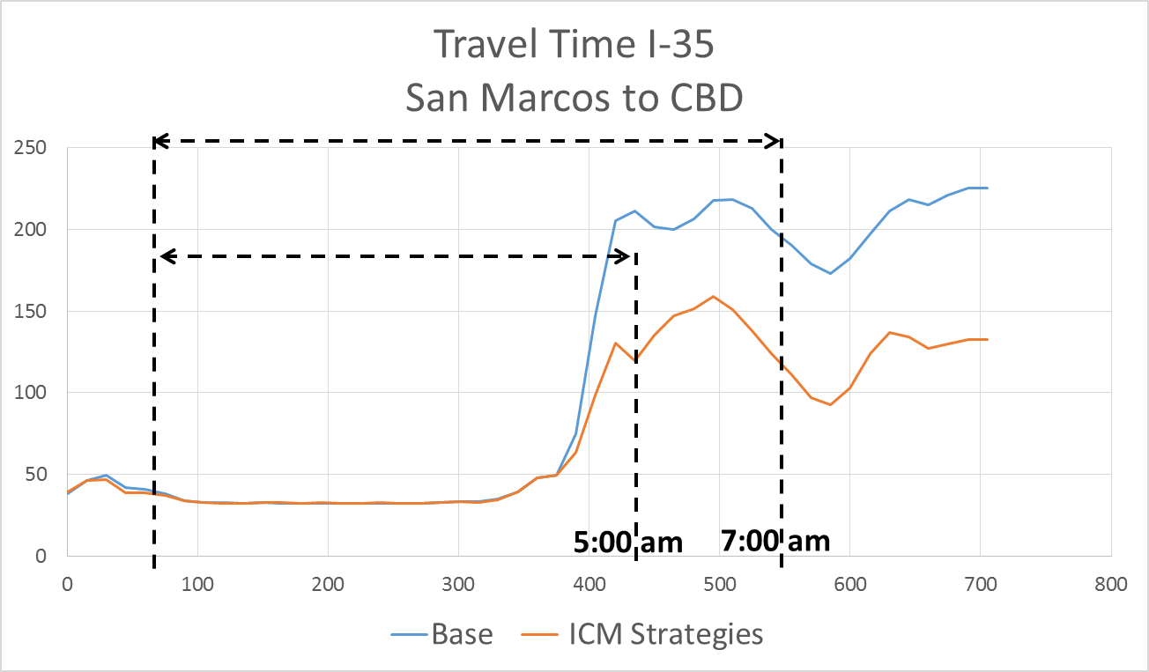
Planned Closure – Travel Time Comparison

Slide 5
Planned Closure - Heat Maps
Base
ICM
Cesar Chavez
Work Zone
SH 45
Improvement in speed beyond morning peak
San Marcos
5:00
am
7:00
am
5:00
am
7:00
am

Slide 6
Unplanned Closure
Base case
All 4 lanes closed on I-35
Used actual incident data (fatality)
Use DMS to divert traffic to alternate routes
Strategies
ICM 1: DMS diversion to frontage road north of incident
ICM 2: Adjust signal timing plans on frontage
ICM 3: Additional DMS messaging to promote more diversion routes
I-35 Austin, TX
DMS

Slide 7
Unplanned Closure
As additional ICM strategies are modeled, delays on I-35 are reduced

Slide 8
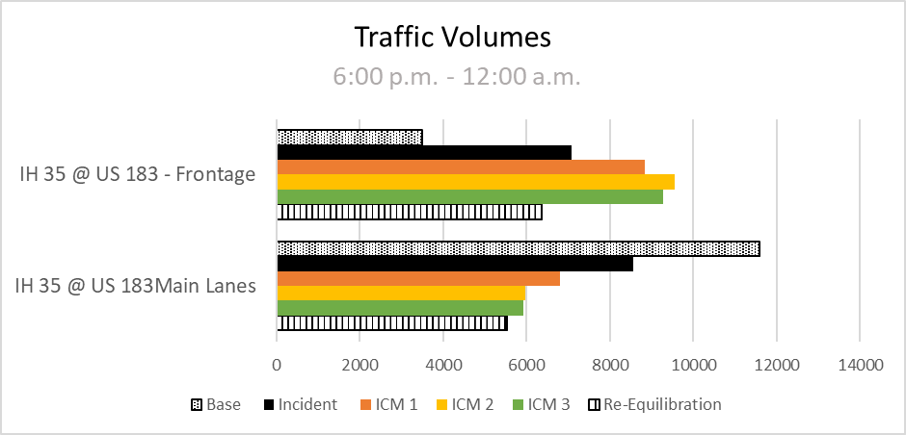
Unplanned Closure
I-35 @ US 183 – Frontage Road
I-35 @ US 183 – Main Lanes

Slide 9
Road User Cost
Section | Base | SH Only | SH + Arterials
San Marcos | $ 883,185 | $ 882,680 | $ 881,965
Kyle | $ 854,793 | $ 855,815 | $ 855,129
SH 45 | $ 824,281 | $ 825,386 | $ 824,798
Slaughter | $ 810,109 | $ 811,382 | $ 810,891
William Cannon | $ 810,860 | $ 812,289 | $ 811,752
SH 71 | $ 829,151 | $ 830,604 | $ 830,114

Slide 10
Conclusion
ICM strategies improve mobility by shifting traffic away from highly congested areas
DTA model provides valuable insights on the impacts of ICM
Road user costs quantify congestion into monetary values
Challenges
Predicting driver behavior
Traffic control

Slide 11
Thank You
John Nevares – TxDOT
Adam Kaliszewski – TxDOT
Natalia Ruiz Juri – UT Austin
Heidi Ross – UT Austin
Matt Miller – TTI
Debra Vermillion – HNTB
Rob Belarimo - HNTB

